Slide 1
Contactless Voucher

Slide 2
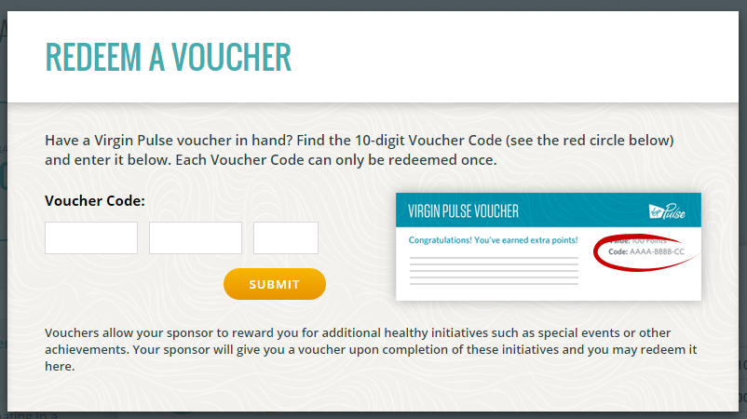

Problem statement
The problem intended to solve
Voucher to use
New process for redemption
Notes:
Images source:
https://virginpulse.zendesk.com/hc/en-us/article_attachments/201755943/redeemvoucherpop.PNG
https://miro.medium.com/max/4096/1*gubbtdDORoBkLtINkvLEtw.png

Slide 3
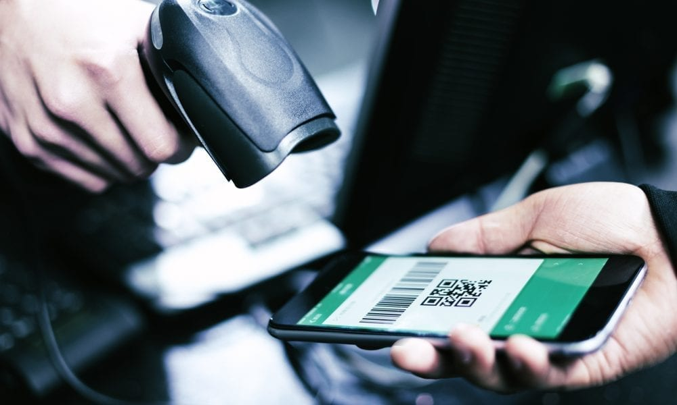

Aim and objectives
What is the point?
Digital vouchers
Contactless payment
Notes:
Images source:
https://techcentral.co.za/wp-content/uploads/2018/06/tap-and-pay-2156-1120.jpg
https://www.pymnts.com/wp-content/uploads/2019/05/NMI-Contactless-Payments.jpg

Slide 4
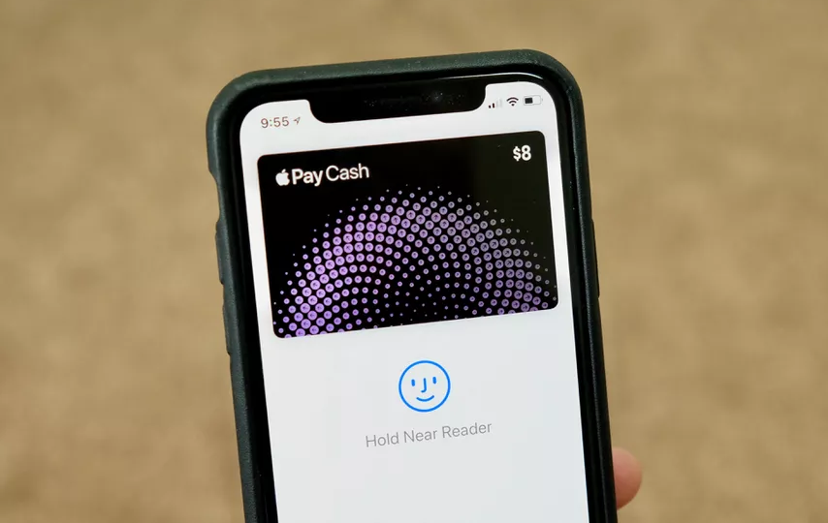

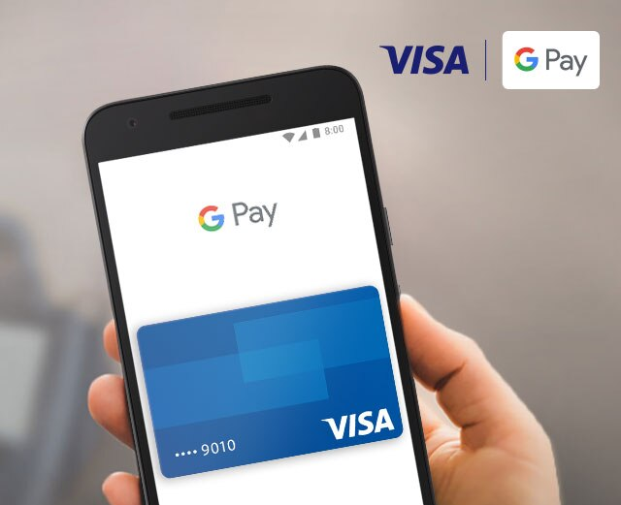
Background
Existing similar or relevant applications
Apple Pay
Android Pay Google Pay
Notes:
Images source:
https://usa.visa.com/dam/VCOM/global/pay-with-visa/images/visa-googlepay-marquee-v1-mobile-640x640.jpg
https://www.silicon.co.uk/wp-content/uploads/2018/02/Android-Pay-1.jpg
https://cnet1.cbsistatic.com/img/UGCf1u6i3HdTwkhpYfohGO2iB94=/940x0/2017/11/08/15c7bbbf-d5eb-4e63-b2c8-42dc4f18534e/apple-pay-cash.jpg

Slide 5




Prerequisites – tools and skills
Notes:
Images source:
https://cdn.tutsplus.com/net/uploads/2013/08/github-collab-retina-preview.gif
https://techcrunch.com/wp-content/uploads/2017/02/android-studio-logo.png?w=730&crop=1
https://www.mgenesis.com/wp-content/uploads/2016/04/VisualStudio-624x220.png
https://www.sencha.com/wp-content/uploads/2018/04/paymo-logo.png

Slide 6
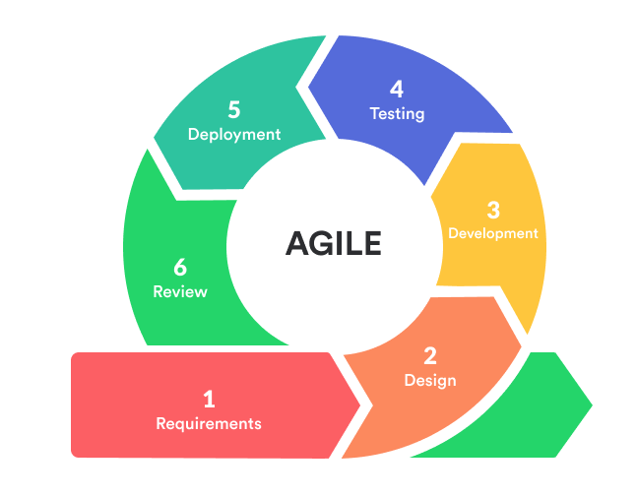
Initial list of requirements
Display NFC disabled or relevant error message
Add a voucher by redirect of a web page
Option to enter manually for later use
Notes:
Sources:
https://d32myzxfxyl12w.cloudfront.net/assets/images/article_images/925d76d668dc5bf47d44a8fc0907f30d1d9c8b1f.png?1557486197
https://plan.io/blog/ultimate-guide-to-implementing-agile-project-management-and-scrum/
https://lvivity.com/software-development-methodologies

Slide 7
Challenges presented by the project
Unknown mechanics of the technology
Fast service and reliable
Security of the process
Notes:
Images source:

Slide 8
Expected learning outcomes
Make demo with companies to receive feedback
Discuss and make survey to collect requirements
Follow milestones
Document every decision made with reasoning
Notes:
Images source:

Slide 9
Project timeline
Complete initial requirements (7th Nov)
Working prototype (mid December)
Final software (26th Feb)
Report complete draft (end March)
Final report (30th April)
Notes:
Images source:

